Slide 1
Climate-Resilient Fisheries Planning Tool
Slide and Image Bank for Facilitators
Climate-Resilient Fisheries Planning Tool

Slide 2
Instructions
The images below are intended to support facilitators in preparing in-person workshops with fishery participants, community members, and other partners. They are drawn from the Climate-Resilient Fisheries (CRF) Planning Tool website, related publications, and associated initiatives.
Each image includes a brief description, relevant website links, and a citation where applicable. Please ensure proper attribution when using these images.
Climate-Resilient Fisheries Planning Tool

Slide 3
CRF Planning Tool Logo
Logo- White
Logo- Color
Climate-Resilient Fisheries Planning Tool

Slide 4
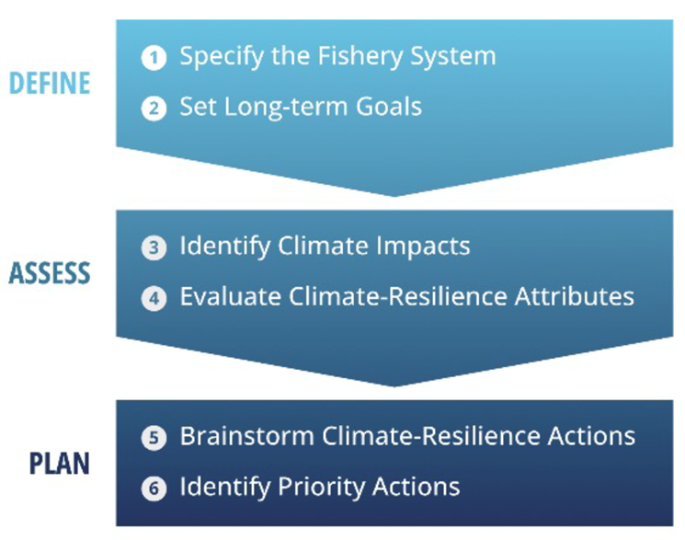
CRF Planning Tool Steps
Diagram explaining CRF Planning Tool six-step process to assess their fishery’s climate resilience and identify approaches and priority actions to help build resilience in their fishery.
Climate-Resilient Fisheries Planning Tool

Slide 5
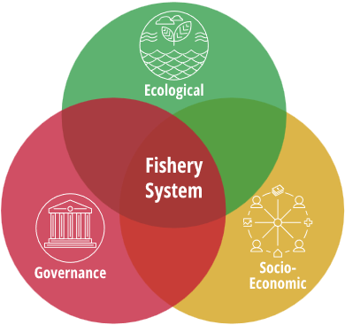
Figures to define a fishery
CRF Planning Tool Step 1: Fishery System
Suggested dimensions: Ecological, socio-economic, and governance dimensions of fishery systems contribute to their climate resilience.
Generic System Map: This figure shows a generic example of a fishery system illustrated in a simple diagram.
CRF Planning Tool Step 1

Slide 6
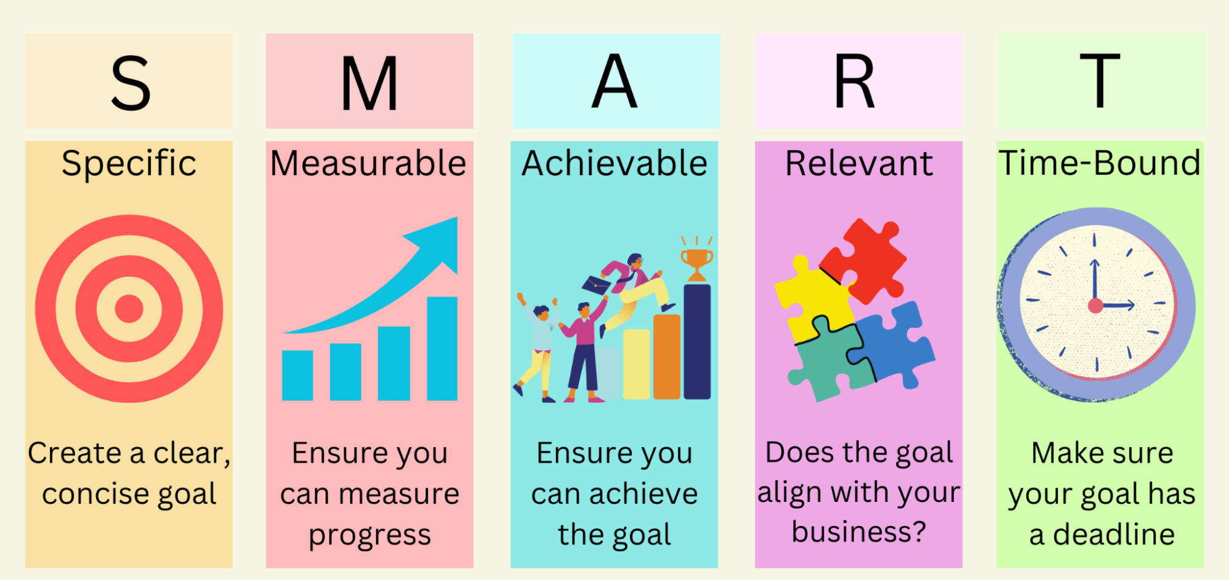
CRF Planning Tool Step 2: Setting Goals
S.M.A.R.T. Goals: Guidance for how to develop goals
CRF Planning Tool Step 2

Slide 7
CRF Planning Tool Step 3: Climate Impacts
Examples of Stressors that Affect Fisheries
CRF Planning Tool Step 3

Slide 8
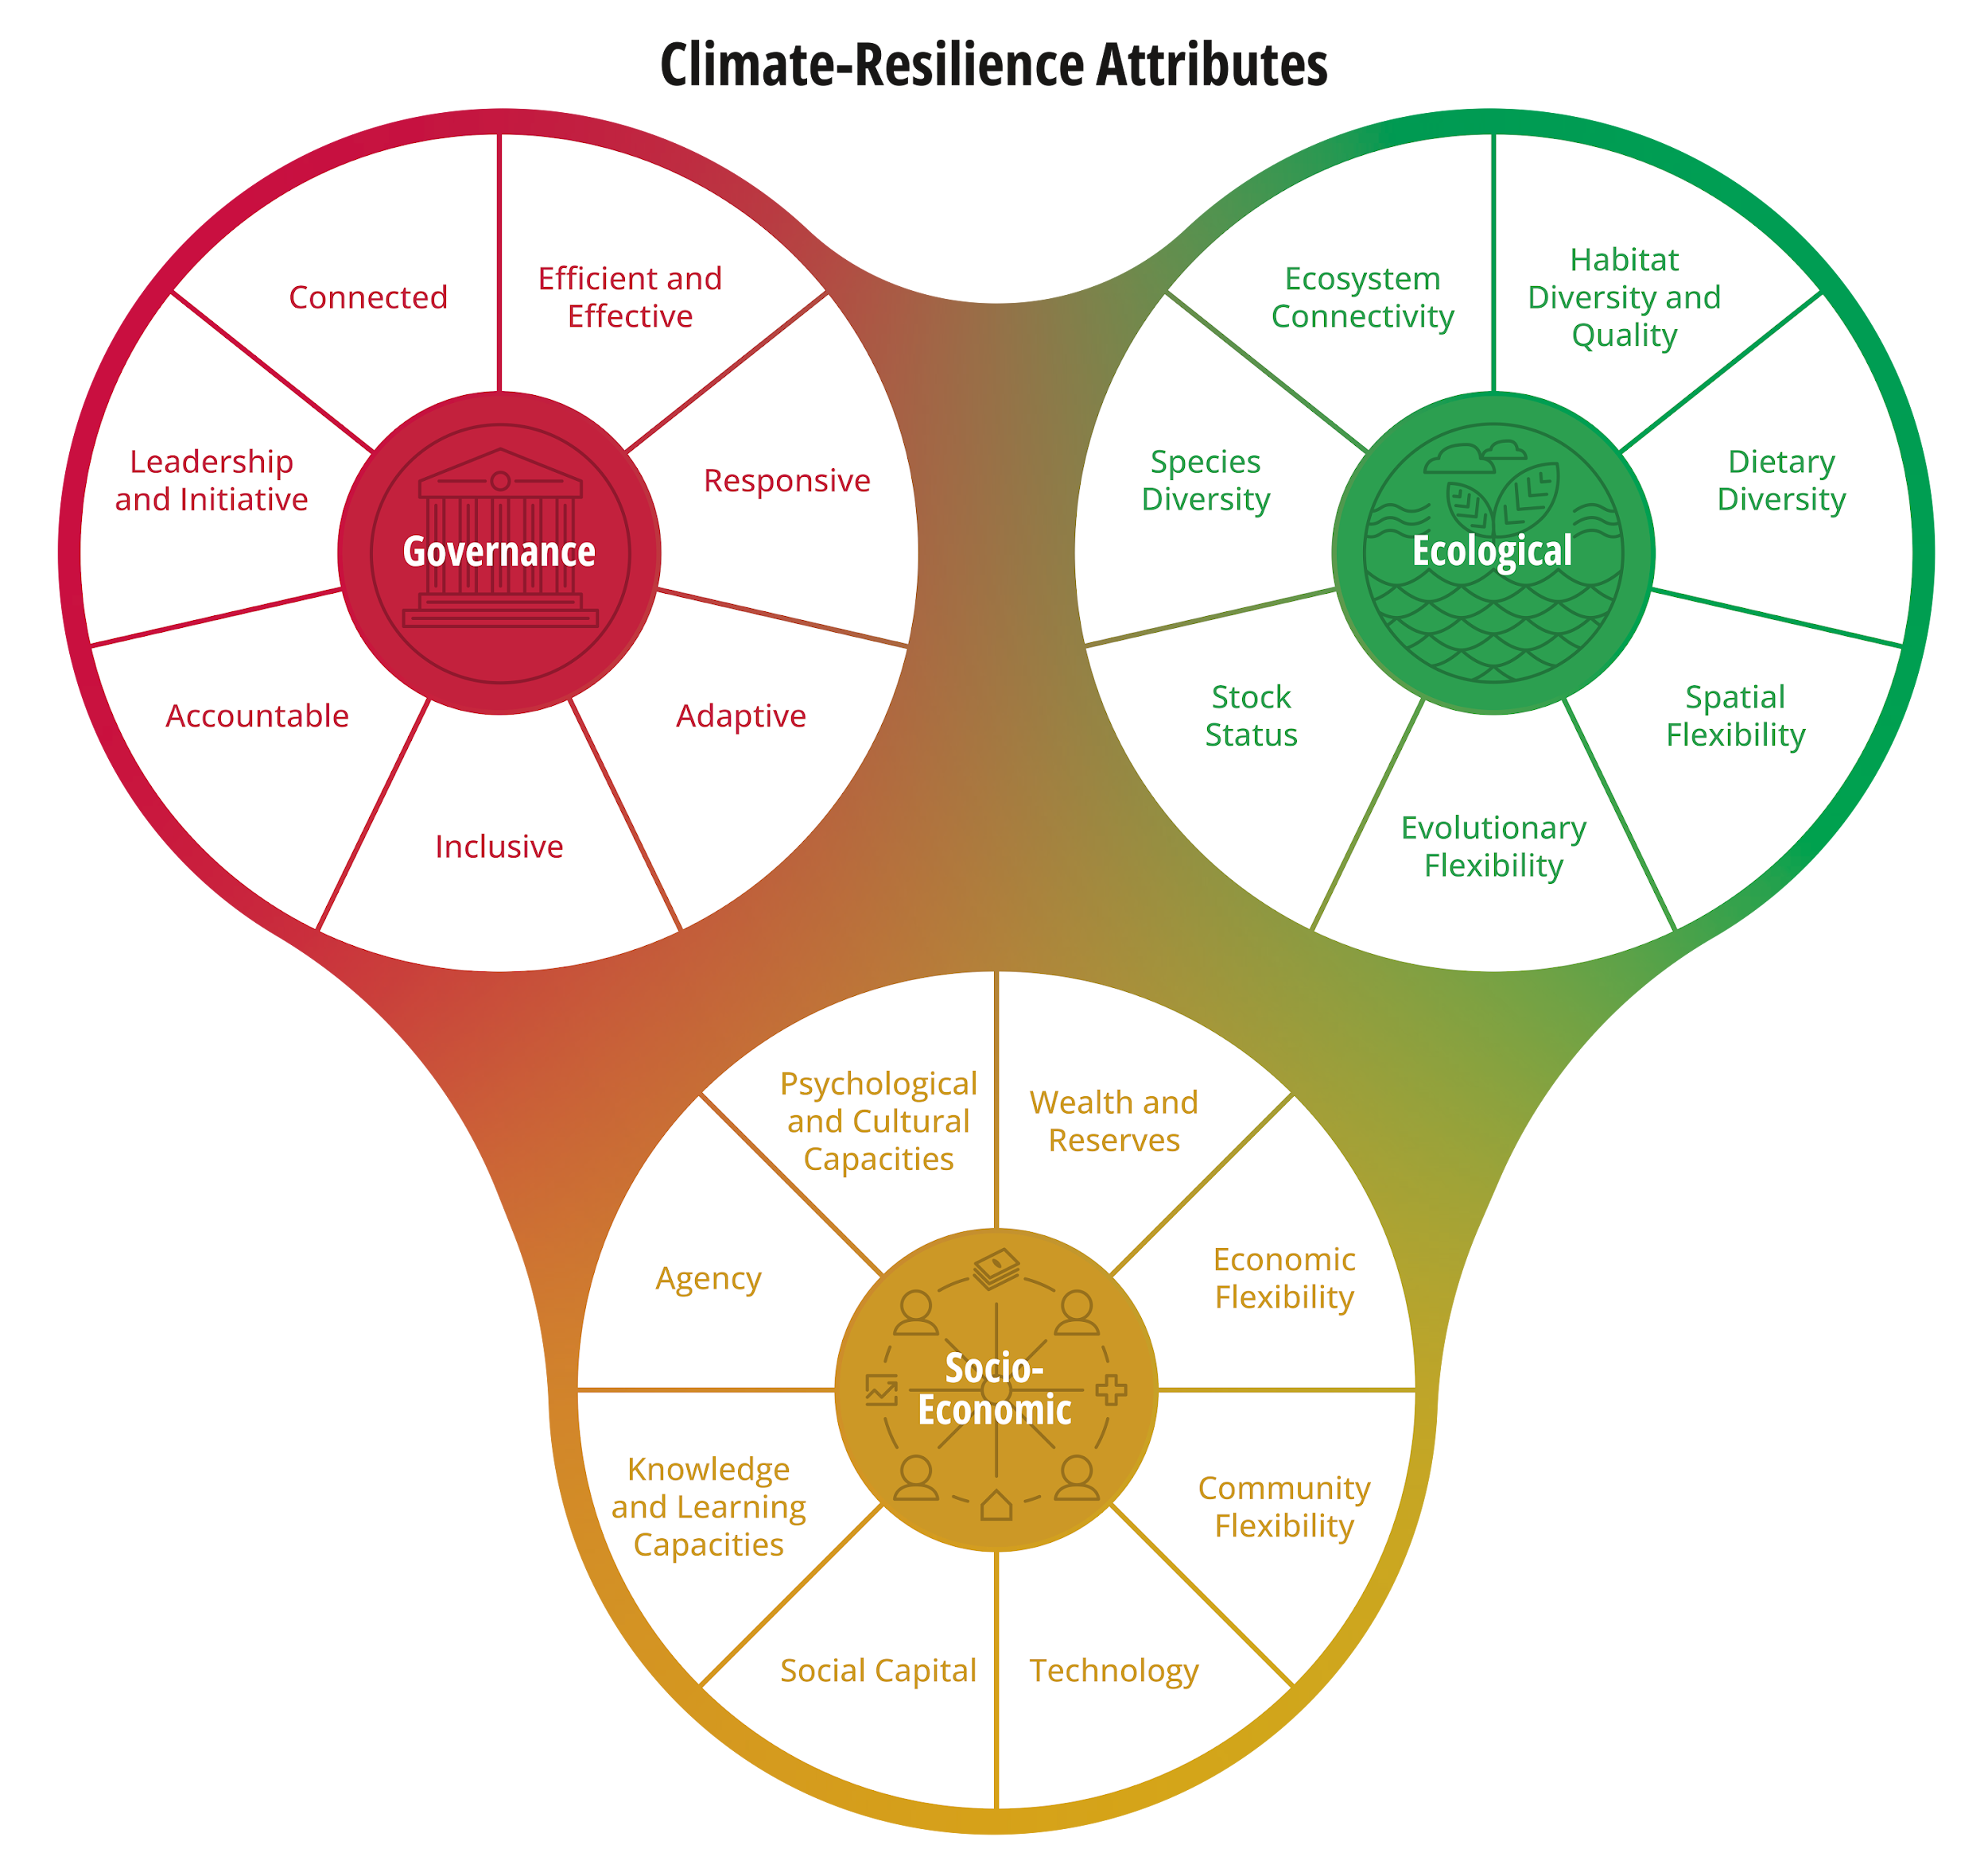
CRF Planning Tool Step 4: Evaluate Attributes
Climate-Resilience Attributes
CRF Planning Tool Step 4

Slide 9
Impact Icons & Resilience Attributes Icons
CRF Planning Tool Step 5: Resilience Actions
Decreased catch
Loss of Infrastructure
Loss of wealth/assets
Ecological Icon
Socio- economic Icon
Governance Icon
CRF Planning Tool Step 5

Slide 10
CRF Planning Tool Step 6: Prioritize Actions
Factors to Consider When Prioritizing Actions
CRF Planning Tool Step 6

Slide 11
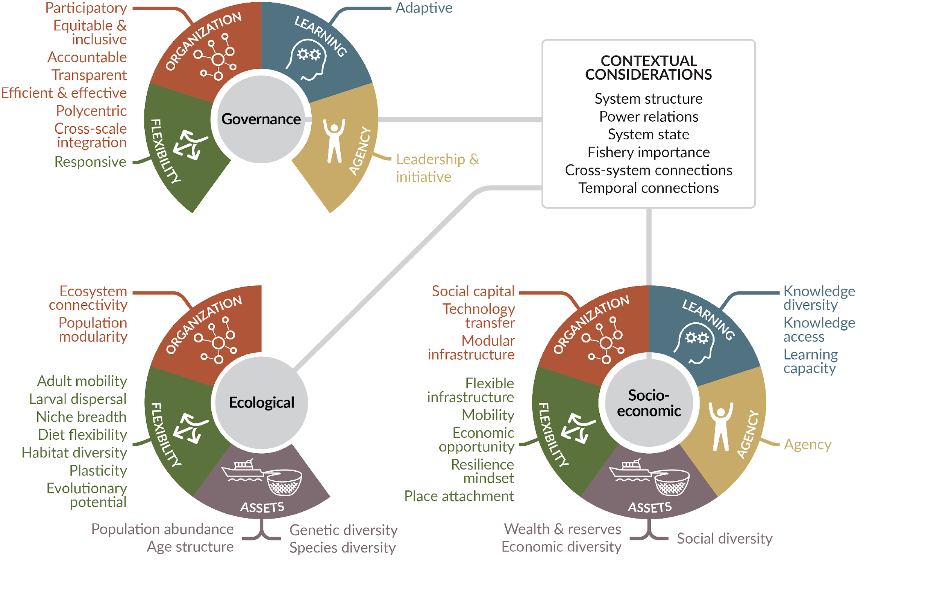
Background: Fishery Domains and Resilience Attributes
Citation:
Mason, Eurich, Lau et al. 2022 Fish and Fisheries
https://doi.org/10.1111/faf.12630
Thirty-eight attributes of climate resilience across ecological, socio-economic and governance dimensions of fisheries, categorized across five resilience domains.

Slide 12
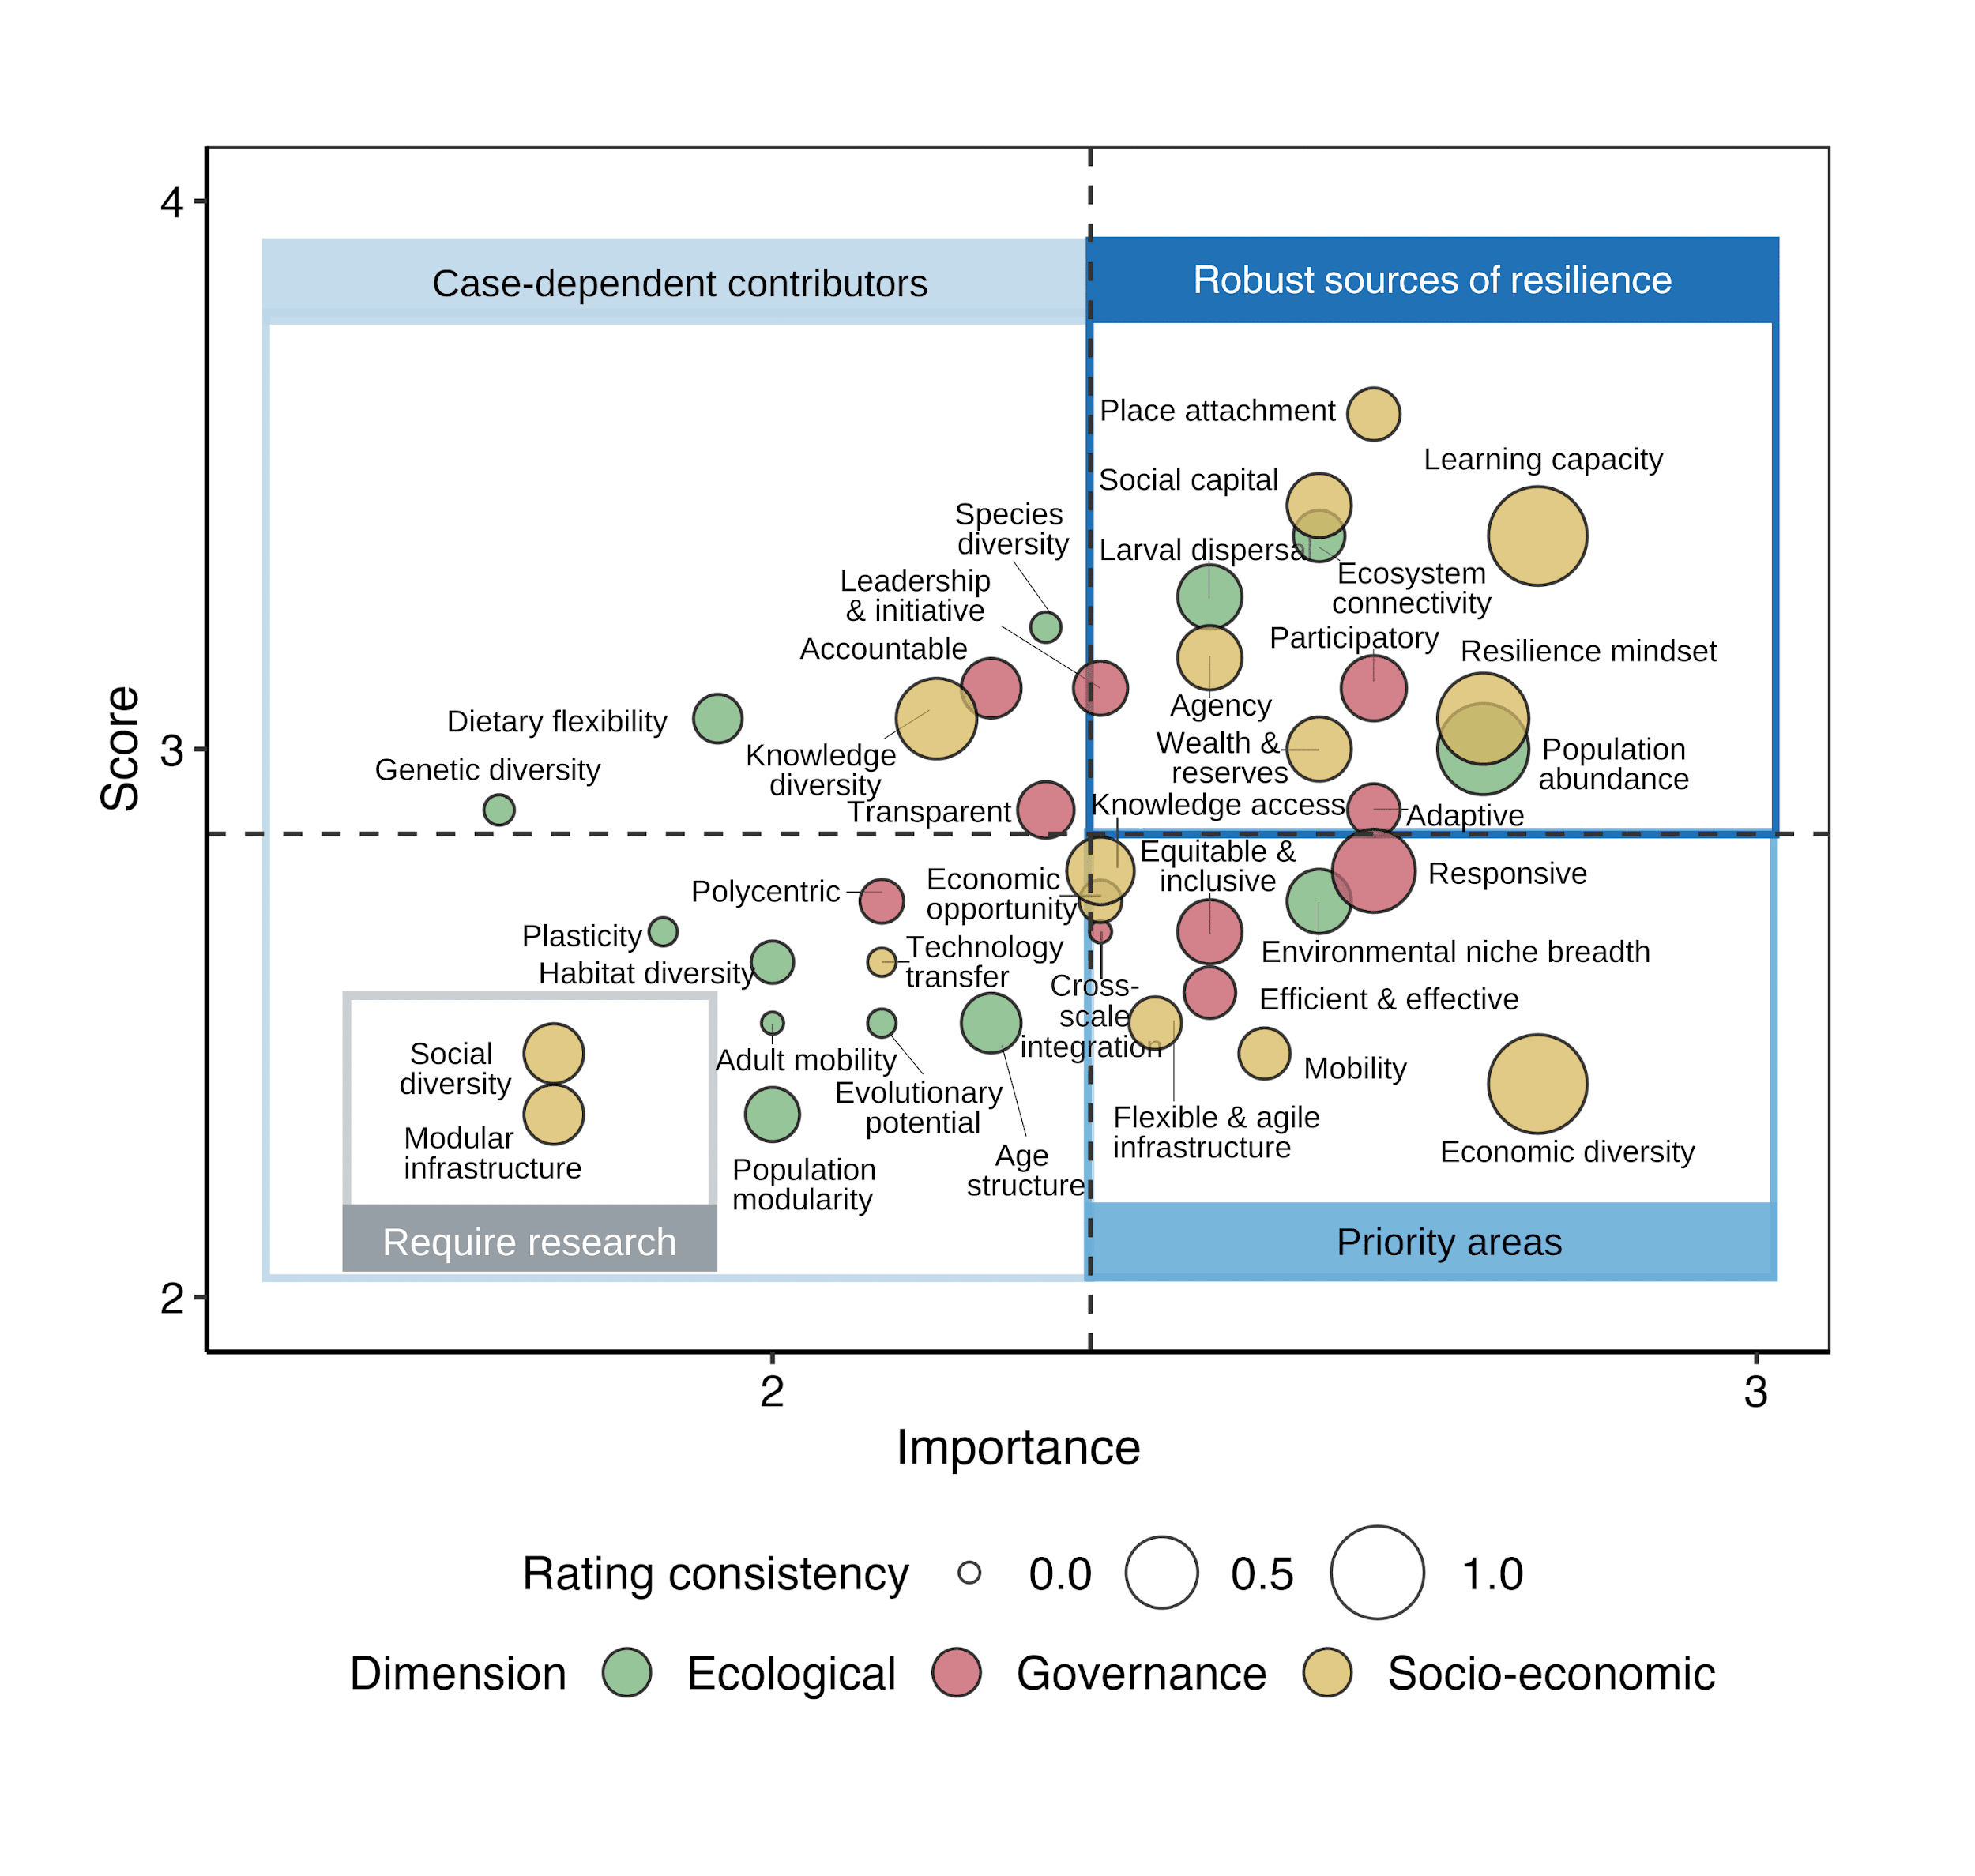
Background: Pathways for Climate Resilience
Map of the location of 18 evaluated case studies spanning diverse geographies, target species, fishery scales and management contexts.
A general typology of resilience attributes across fishery case studies.
Citation:
Eurich, Friedman, Kleisner, Zhao et al. 2024 Fish and Fisheries https://doi.org/10.1111/faf.12790

Slide 13
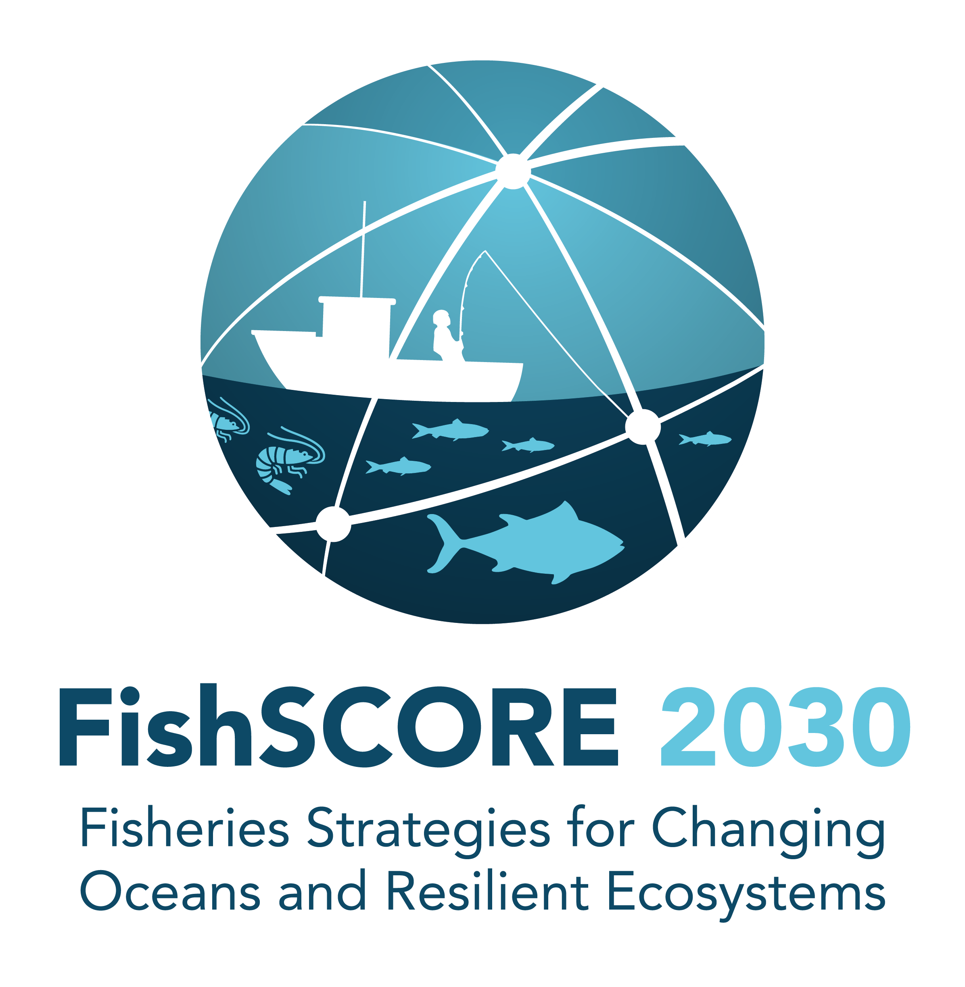
FishSCORE 2030 Logo
FishSCORE2030 aims to advance climate resilience, sustainability, and equity in marine fisheries through climate assessments, actionable strategies, and a global research network to achieve sustainable development goals in a changing ocean.
The FishSCORE2030 Approach

Slide 14
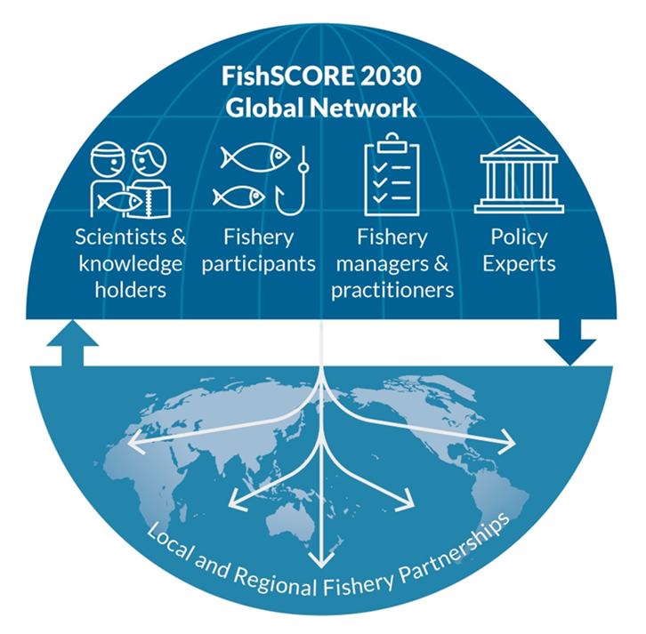
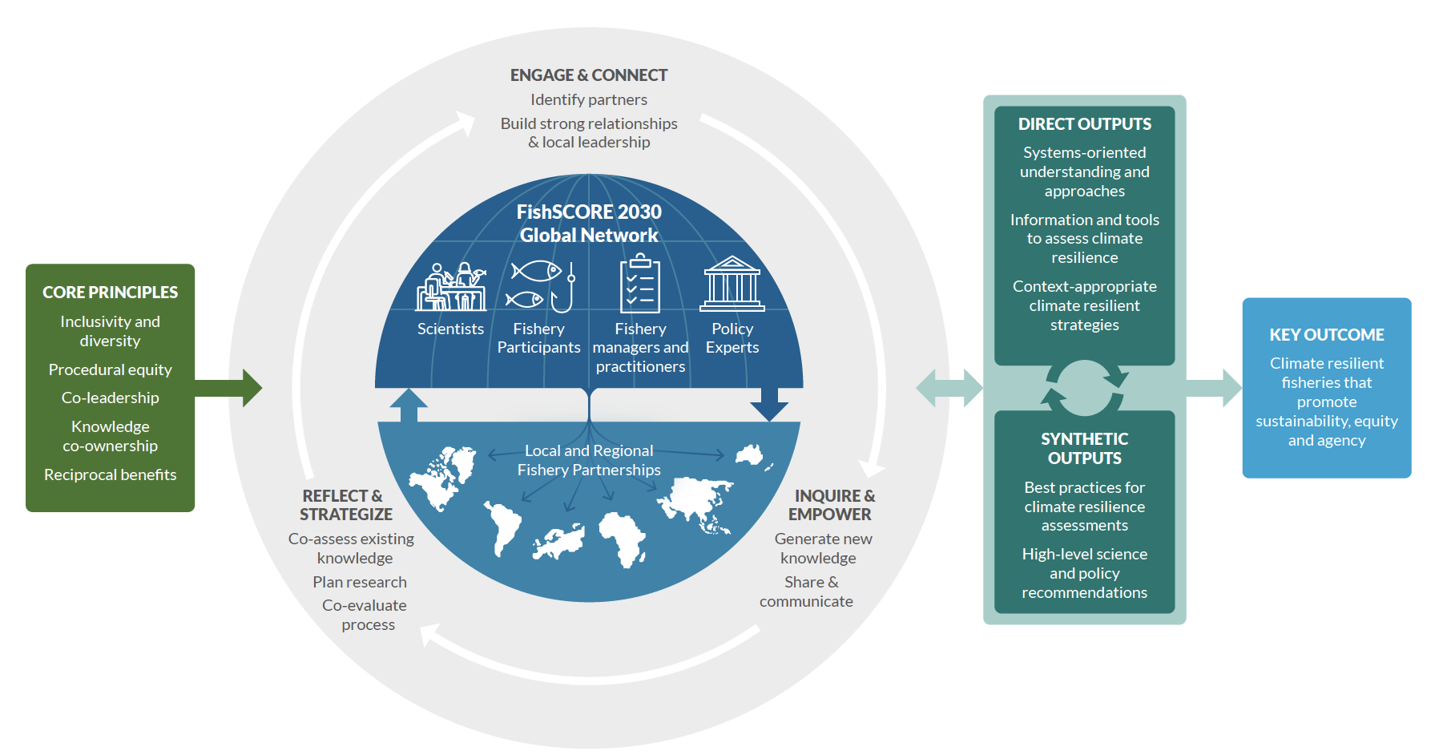
FishSCORE 2030 Networks
Diagram of a FishSCORE2030 global network
The FishSCORE2030 Network
Citation:
Mills et al. 2022 ICES JMS
https://doi.org/10.1093/icesjms/fsac110

